Slide 1
STUDENT DETAILS
Name : Sai tejasri Eraboina
Email id : tejasrieraboina@gmail.com
College Name : Vaagdevi Degree & Pg college
Domain : Data Science

Slide 2
ANALYSIS OF MENTAL FITNESS REVIEW IBM SKILL BASED PROJECT INTERNSHIP

Slide 3
Mental fitness is defined as a state of well-being and having a positive sense of how we feel, think, and act.
It means keeping your brain and emotional health in good shape. It doesn’t mean acing a test or practicing memory games or thinking puzzles, but rather exercises that keep you mentally well and build up your resilience to stress.
The concept of mental fitness has only emerged in the past few years, and is meant to help people understand that like physical fitness, mental fitness is just as important and should not be neglected within our society. It helps people understand that just as we can improve our physical health by moving our bodies, we improve our mental health by strengthening our minds.

Slide 4
AGENDA
As the influence of the social media network nowadays it’s going viral with many of the apps like astrology to meet with them.
The same mentality can be applied to mental health. We are all prone to certain conditions depending on our family history and environment, however many of us may not think to set goals to ensure they stay mentally fit. For example, if your family has a history of anxiety, goals of yours may include journaling, meditation, regular sleep, and keeping stress and anxiety levels low.
Just as there are four components to physical fitness—cardiovascular endurance, strength, flexibility, and a healthy weight—there are also four components to mental fitness

Slide 5
PROJECT OVERVIEW
Our brains carry thoughts along neural pathways. These pathways are like ruts that have been created and reinforced over time. If you always take the same route to work, you may notice that you can get there on “autopilot.” When we repeat a certain thought pattern many times, that neural pathway is reinforced, and the thinking becomes automatic.
By building mental fitness training into your life, you have a greater chance of lowering your symptoms of stress, anxiety, burnout, and depression. It also often helps you achieve a sense of peacefulness through guided imagery and mindfulness strategies. These practices can reduce tension in both your body and your mind by helping you break unhelpful thought or mood patterns.

Slide 6
SKILLS
Developing the skills for better mental fitness can benefit you and everyone around you.
Being more present: In a more present state, we can better retain and process information, listen, and be aware of, without being sabotaged by distractions.
Ability to respond instead of reacting: When we have more control over our automatic thoughts, we can choose to respond in a more rational and less emotive way.
Improved cognitive functioning: Better focus, processing speed, memory, concentration, time management, and communication have a positive impact, personally and professionally.
Increased Positivity: With increased awareness comes the ability to notice and reframe thoughts in more helpful ways. This often results in kinder thoughts, compassion, and optimistic mindsets.
More confidence: By reframing our thoughts and our beliefs about ourselves, it can lead to more confidence, self-compassion and empathy.
Skills building: By doing mental fitness training, you can develop life skills to better manage your mental health including thought balancing, goal setting, mood management, etc.

Slide 7
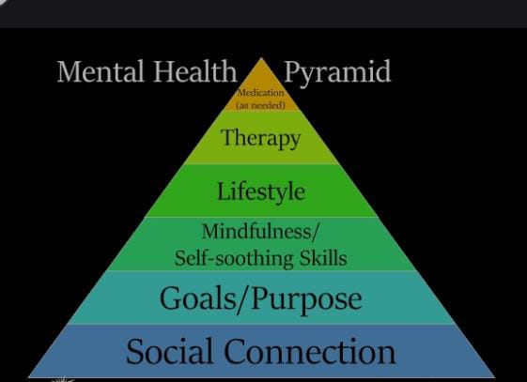
MODELLING
Mental Fitness is a proactive, positive term without the negative connotations associated to mental health or mental illness. Whilst the term Mental Fitness is being increasingly used by psychologists, mental health practitioners, schools, organisations and the general fitness centers.

Slide 8
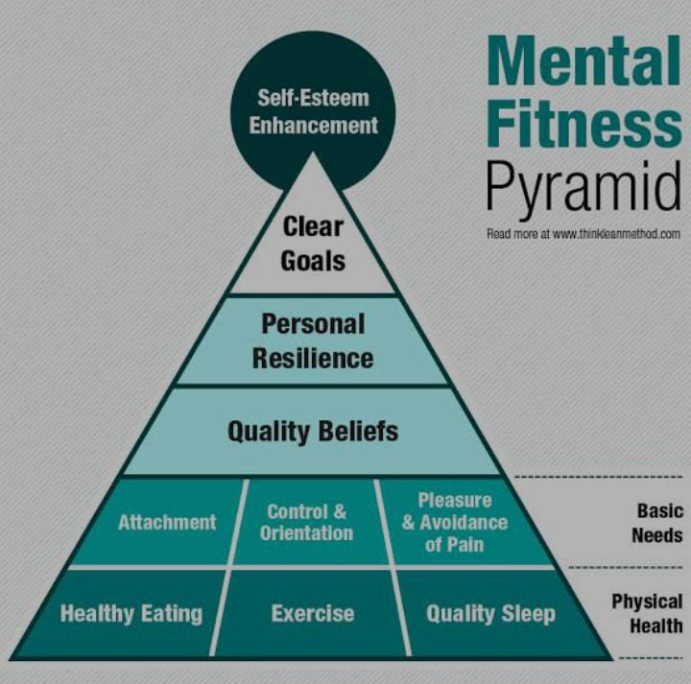
MODEL PERFORMANCE

Slide 9
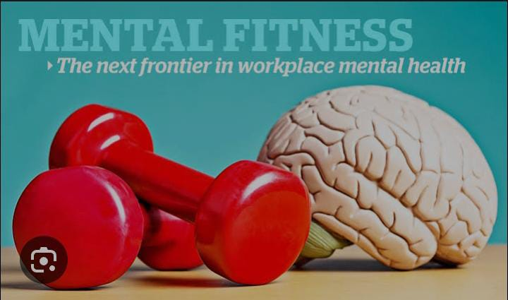
AWARNESS
Whenever we have a moment of joy or sadness, there is always a reason we feel the way we do. Until you are aware of those reasons, you can’t do anything to change them. Building your self-awareness is often one of the first steps to improving your mental fitness. It includes any strategies or tools to help you understand or unpack how you feel.

Slide 10
RESULTS
Our digital CBT platform is proven to deliver outcomes for employees who experience the highest levels of workplace stress.
77% report lower stress, anxiety, and depression
91% of members believe that Starling helps manage their mental health
4 in 5 reduce absences by 6.5 days per year
5 x payback on investment reported by customers

Slide 11
THANK YOU

